Slide 1

Retinal Vessels Segmentation using Deep Learning
Department of Information Technology
Guided by Dr.S.Suma Christal Mary M.E., (Ph.D)
Team Members :
M.Lingesh ( 211519205086)
D.Manoj ( 211519205090)
V.Lokeshwaran (211519205086 )
Incharge by
Mrs.S.Irin Sherly
Asst . Professor

Slide 2
ABSTRACT
The segmentation of retinal blood vessels in the retina is a critical step in diagnosis of diabetic retinopathy. In this paper, we present a new method for automatically segmenting blood vessels in retinal images.
Five basic algorithms for segmenting retinal blood vessels, based on different image processing techniques, are described and their strengths and weaknesses are compared.
A hybrid algorithm that combines the confidence outputs of each basic algorithm is described.
The performance of each algorithm was tested on the DRIVE dataset.
Our hybrid algorithm performs segmentation with similar precision and sensitivity as a trained human observer.

Slide 3
Introduction
The fundus retina image is the only deeper microvascular
system that can be observed non-invasively. The retinal vessel
map contains abundant geometric characteristics, such as
vessel diameter, branch angles, and branch lengths. These
geometric characteristics reflect clinical and pathological
features which are used to diagnose hypertension, diabetes,
and atherosclerosis.
The ophthalmologist uses retinal blood vessels to diagnose vascular and vascular systemlesions related diseases, which interprets diabetic retinopathy (DR) and diabetic maculopathy (MD). These are the leading causes of global blindness. Retinal image assessment has been an indispensable step for the identification of retinal pathology.
Retinal fundus image illustrates retina structure, such asretinal blood vessel tree, optic disk (OD), fovea, macula and abnormal structures.

Slide 4
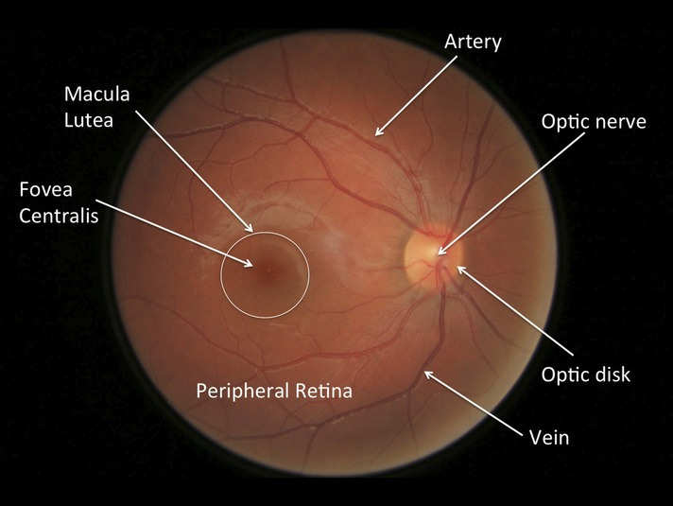
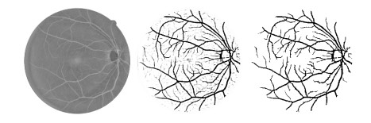
Retina segmentation
Structure of Retina:
Annotated Structure Of Retina :

Slide 5
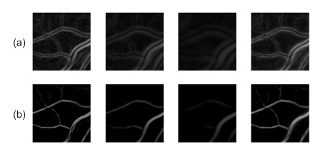
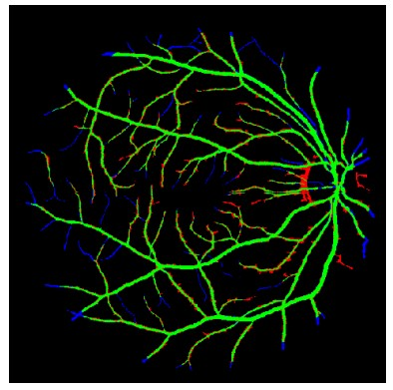
Scale Space Analysis algorithm of Retina
Scale-space analysis for a 100 × 100 portion of a retinal image
Sample result for scale-space analysis algorithm . True positives (green), false positives (red), false negatives (blue), true negatives (black).

Slide 6
Problem Definition
This presents a comprehensive review of retinal blood vessel segmentation based on deep learning. The geometric characteristics of retinal vessels reflect the health status of patients and help to diagnose some diseases such as diabetes and hypertension.
The deep learning algorithms have been rapidly applied to retinal vessel segmentation due to their higher accuracy, when compared with anual segmentation and other computer-aided diagnosis techniques .
The obstacles and key aspects for applying deep learning
to retinal vessel segmentation and future indicated
research directions.

Slide 7
Literature Survey
Title | Author | Year | Overview
Retinal blood vessel segmentation based on: International Journal of Advanced Research in Electrical, Electronics and Instrumentation Engineering | Joon huang chuah | 2021 | The approach provides a Deep learning proposed model based on the Convolutional Neural Network (CNN) which was inspired by multi layer image processing .

Slide 8
Existing System
Earlier, some researchers adopted CNNs with only several
layers to segment vessels. We review 7 CNNs
and summarize their performance evaluations.
Fan and Mo applied a 5-layer CNN to vessel segmentation and extracted image patches in the green channel as
input.
According to the comparison between R, G and B
channels, the green channel provides the best
vessel backgroundcontrast than red and blue channels
They extracted image patches in different channels with different sizes and resized them.
Utilizing multiple channels can provide more information
which is helpful for multi-object classification.

Slide 9
Proposed System
CNN with 6 layers and introduced a reinforcement sample learning scheme that trained the network on samples with poor performance.
The most CNNs have just produced about 94% segmentation accuracy.
CNNs have only several convolutional layers and do
not have strong feature representation capacity, then they can
only segment the basic structure.
Machine learning algorithms require handcrafted features and thus are limited by their generalization ability.
Currently, deep learning models have been greatly
used to image segmentation including retinal images since
they do not need any handcrafted features and outperform
existing unsupervised methods.

Slide 10
Requirements
Hardware Requirements :
Intel Processor i5 or above.
8gb Ram
50gb Memory
Windows 10 OS
Software Requirements :
Python Compiler
Mat Lab
Image Processing Tool

Slide 11
Conclusion
Geometric characteristics of retinal vessels reflect clinical
and pathological features.
The ophthalmologist uses vessel maps to diagnose diseases, such as DR and MD.
Precise diagnoses of eye abnormalities and their timely treatment are important in preventing global blindness.
Computerized automatic segmentation for retinal blood
vessels is inspired since manual segmentation of retinal
blood vessels is expensive and time-consuming.
In the past, researchers proposed different methods for automatic retinal vessel segmentation.
Unsupervised models are limited by their accuracy.

